Slide 1
Petfinder pawpularity
Kayla Thompson

Slide 2

Introduction
Petfinder helps adoptable pets find homes.
Adopting a pet is linked to a variety of health and life benefits.
In this project we will build a model that predicts the ”pawpularity” score a pet’s profile will get based on the pet’s photo.

Slide 3
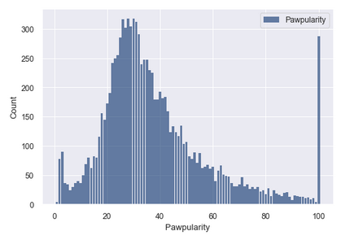
Exploratory Data analysis
Histogram of pawpularity scores
Mean: 38.039
Standard Deviation: 20.59,
Spread: 424.03
Mode is 28 and 30
Tail is 15, 70, 20, 20, 30

Slide 4
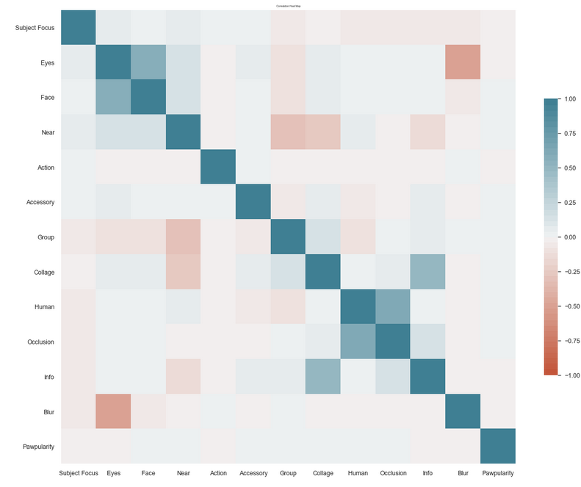
Exploratory Data ANalysis
Correlation plot of all variables
No strong correlation between any one variable and pawpularity score.

Slide 5
Models
Random Forest Model
Root Mean Square Error
20.897
Linear Regression Model
Root Mean Square Error
20.624

Slide 6
Conclusions
Both models have high root mean square error
Several other factors could influence a pet’s pawpularity score
Age
Breed
Temperament
Location
Future analysis is needed with these variables in order to build a more reliable model.

